Slide 1

FRANCISCO COSTA
Silhouette
Language
Raul Ikeda

Slide 2

Silhouette
noun
sil·​hou·​ette /ˌsɪl.əˈwet
1. word used to describe the dark shape and outline of someone or something visible against a lighter background, especially in dim light;

Slide 3
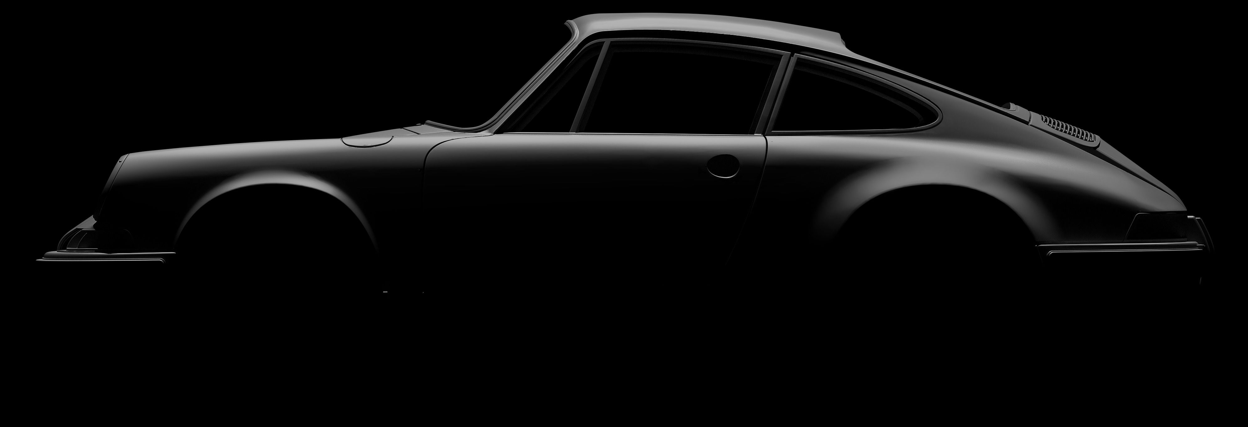
Silhouette
Iconic examples, such as the Porsche 911, can be recognized by their silhouette.
The sleek shape and aesthetic pleasing lines contribute to its iconic status.
Even without seeing the whole car, its silhouette alone is enough to identify it as a 911.

Slide 4
Silhouette
Characteristics
Silhouette Inspirations
The silhouette language follows principles of simplicity and elegance.
Its syntax is designed to be easy to read and write.
It encourages clean code and can be understood at a glance.
It allows for flexibility in syntax choices.
Silhouette builds upon the strengths of languages like C.
C is known for its simplicity, power, and readability.
Silhouette introduces twists and tweaks from more modern syntax languages like Rust and Haskell.
Thus enhancing readability and making it more approachable to new programmers.

Slide 5
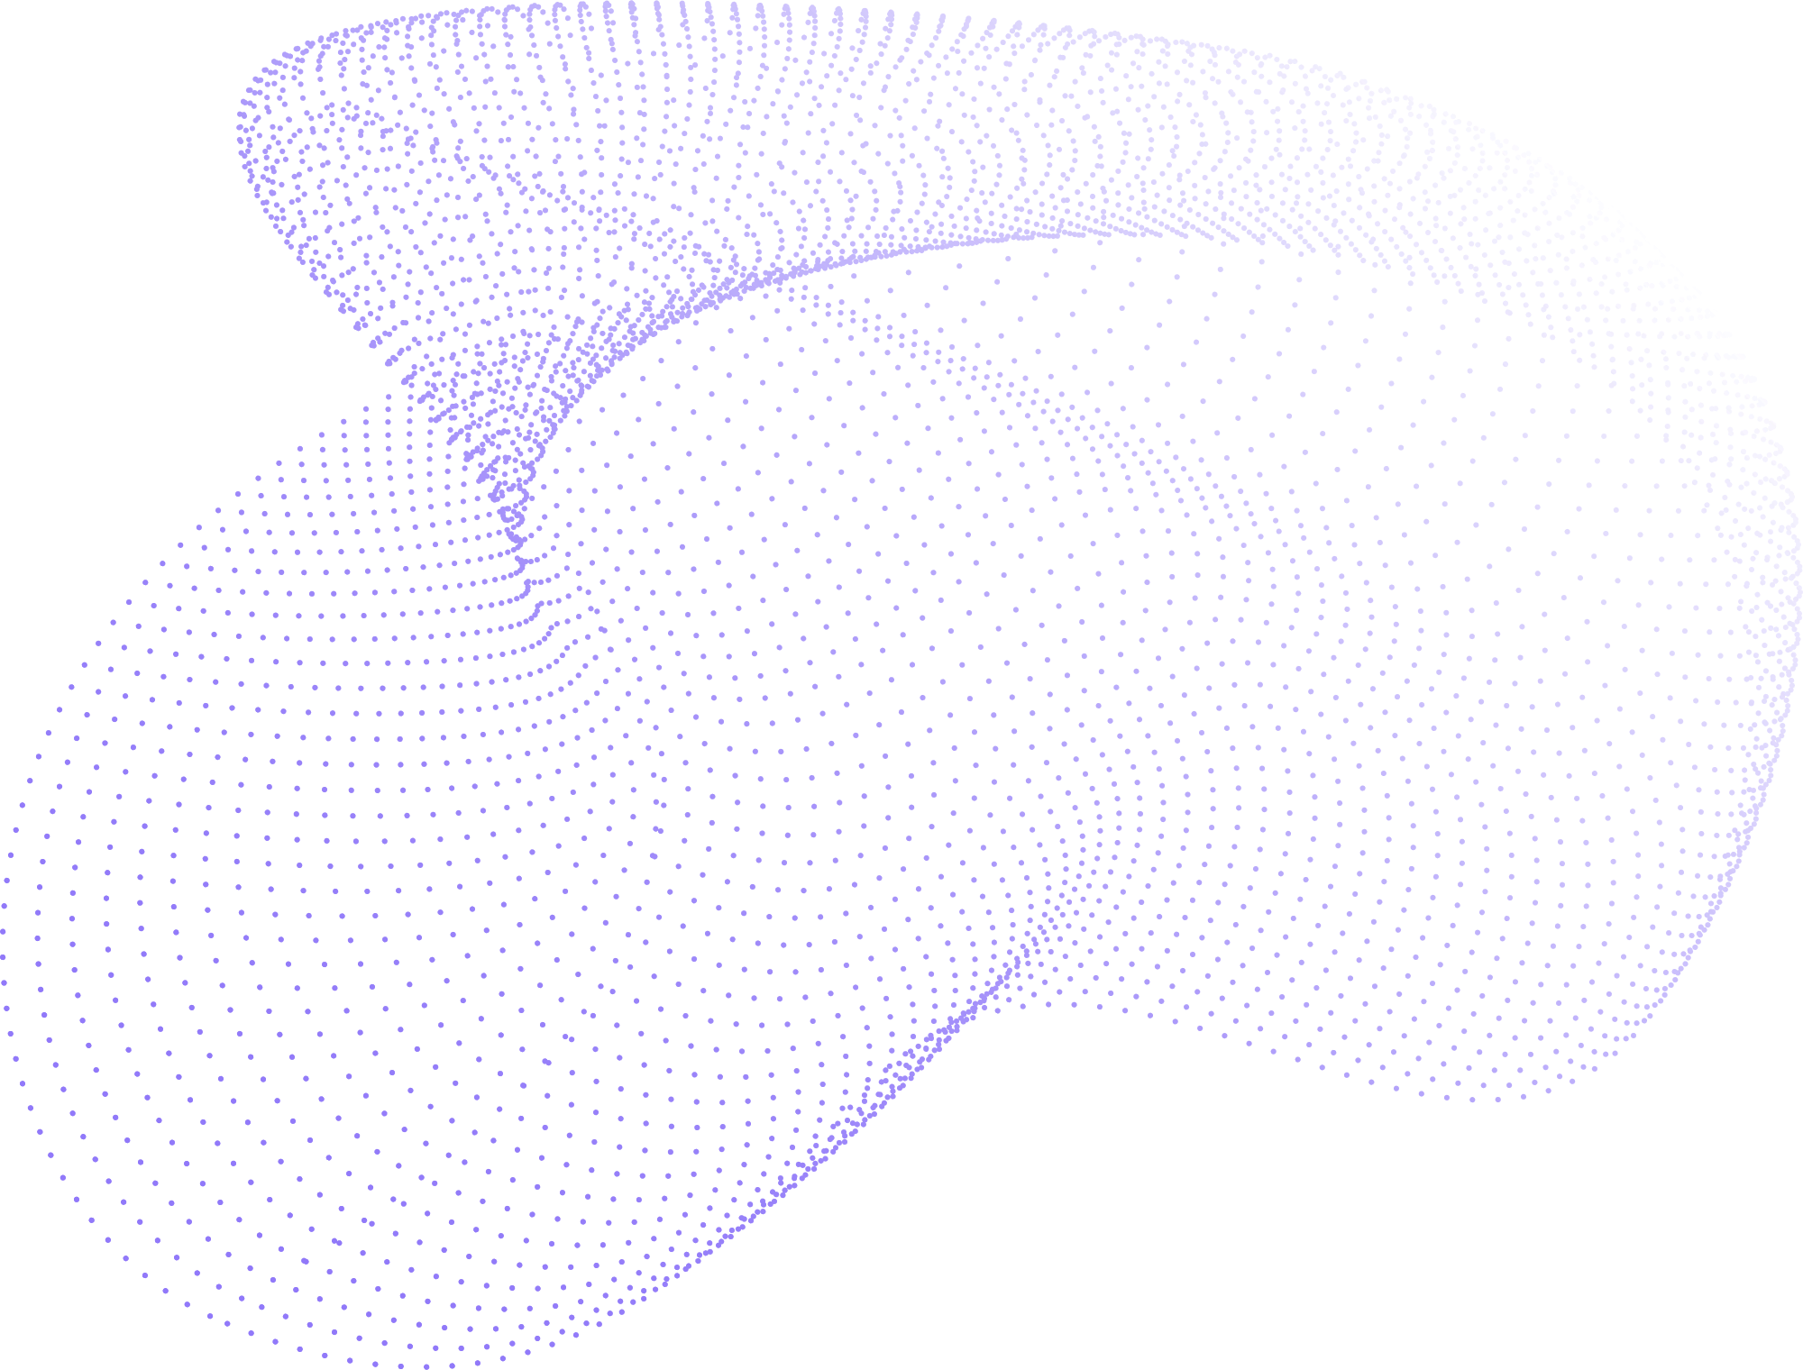
Silhouette-lang Examples
Variable Declaration
Recursion (Loops)
Conditionals
Functions
You can find the resulting intermediate representation (IR) and output of each example in the directory "/compiler/final-test" of the GitHub repository.

Slide 6
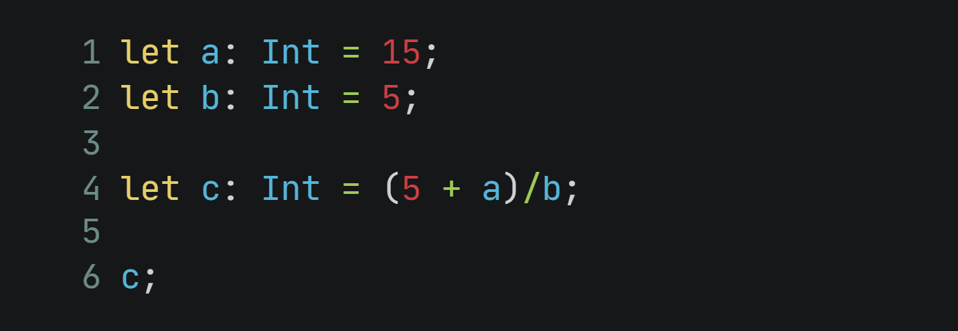
Silhouette-lang Examples
Variable Declaration

Slide 7
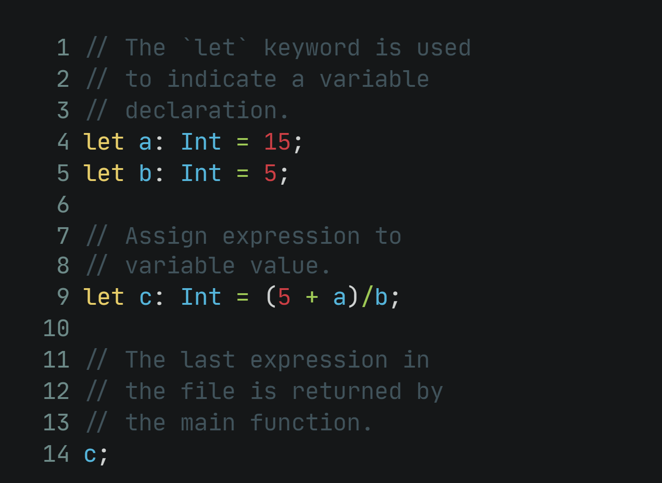
Silhouette-lang Examples
Variable Declaration Notes

Slide 8
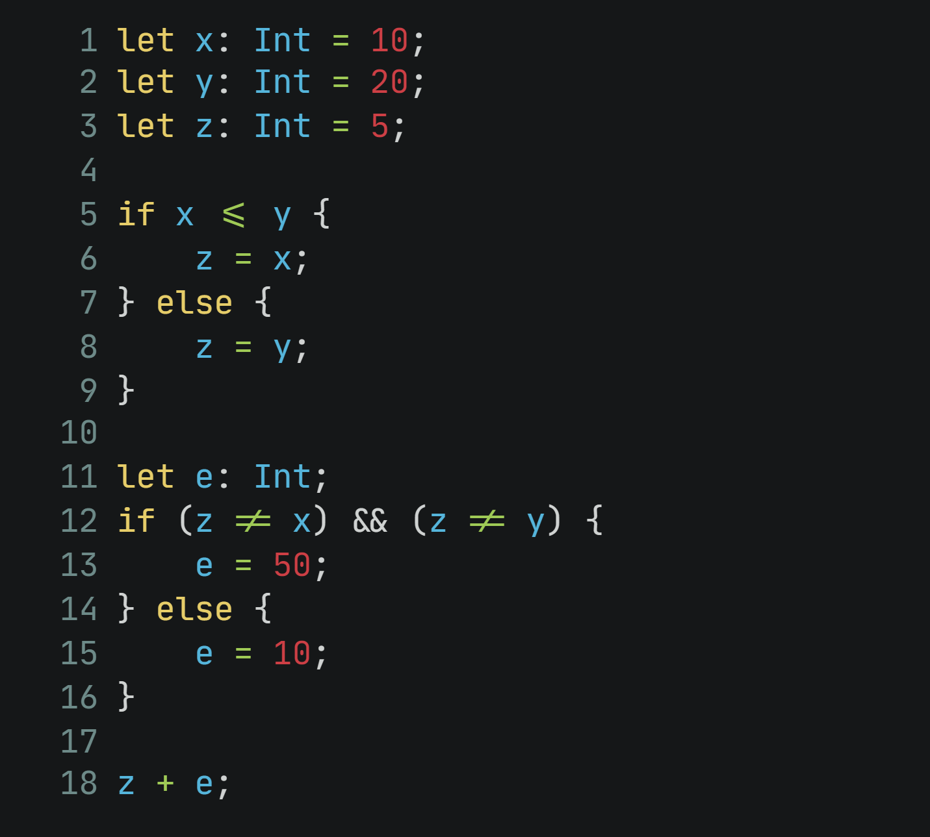
Silhouette-lang Examples
Conditionals

Slide 9
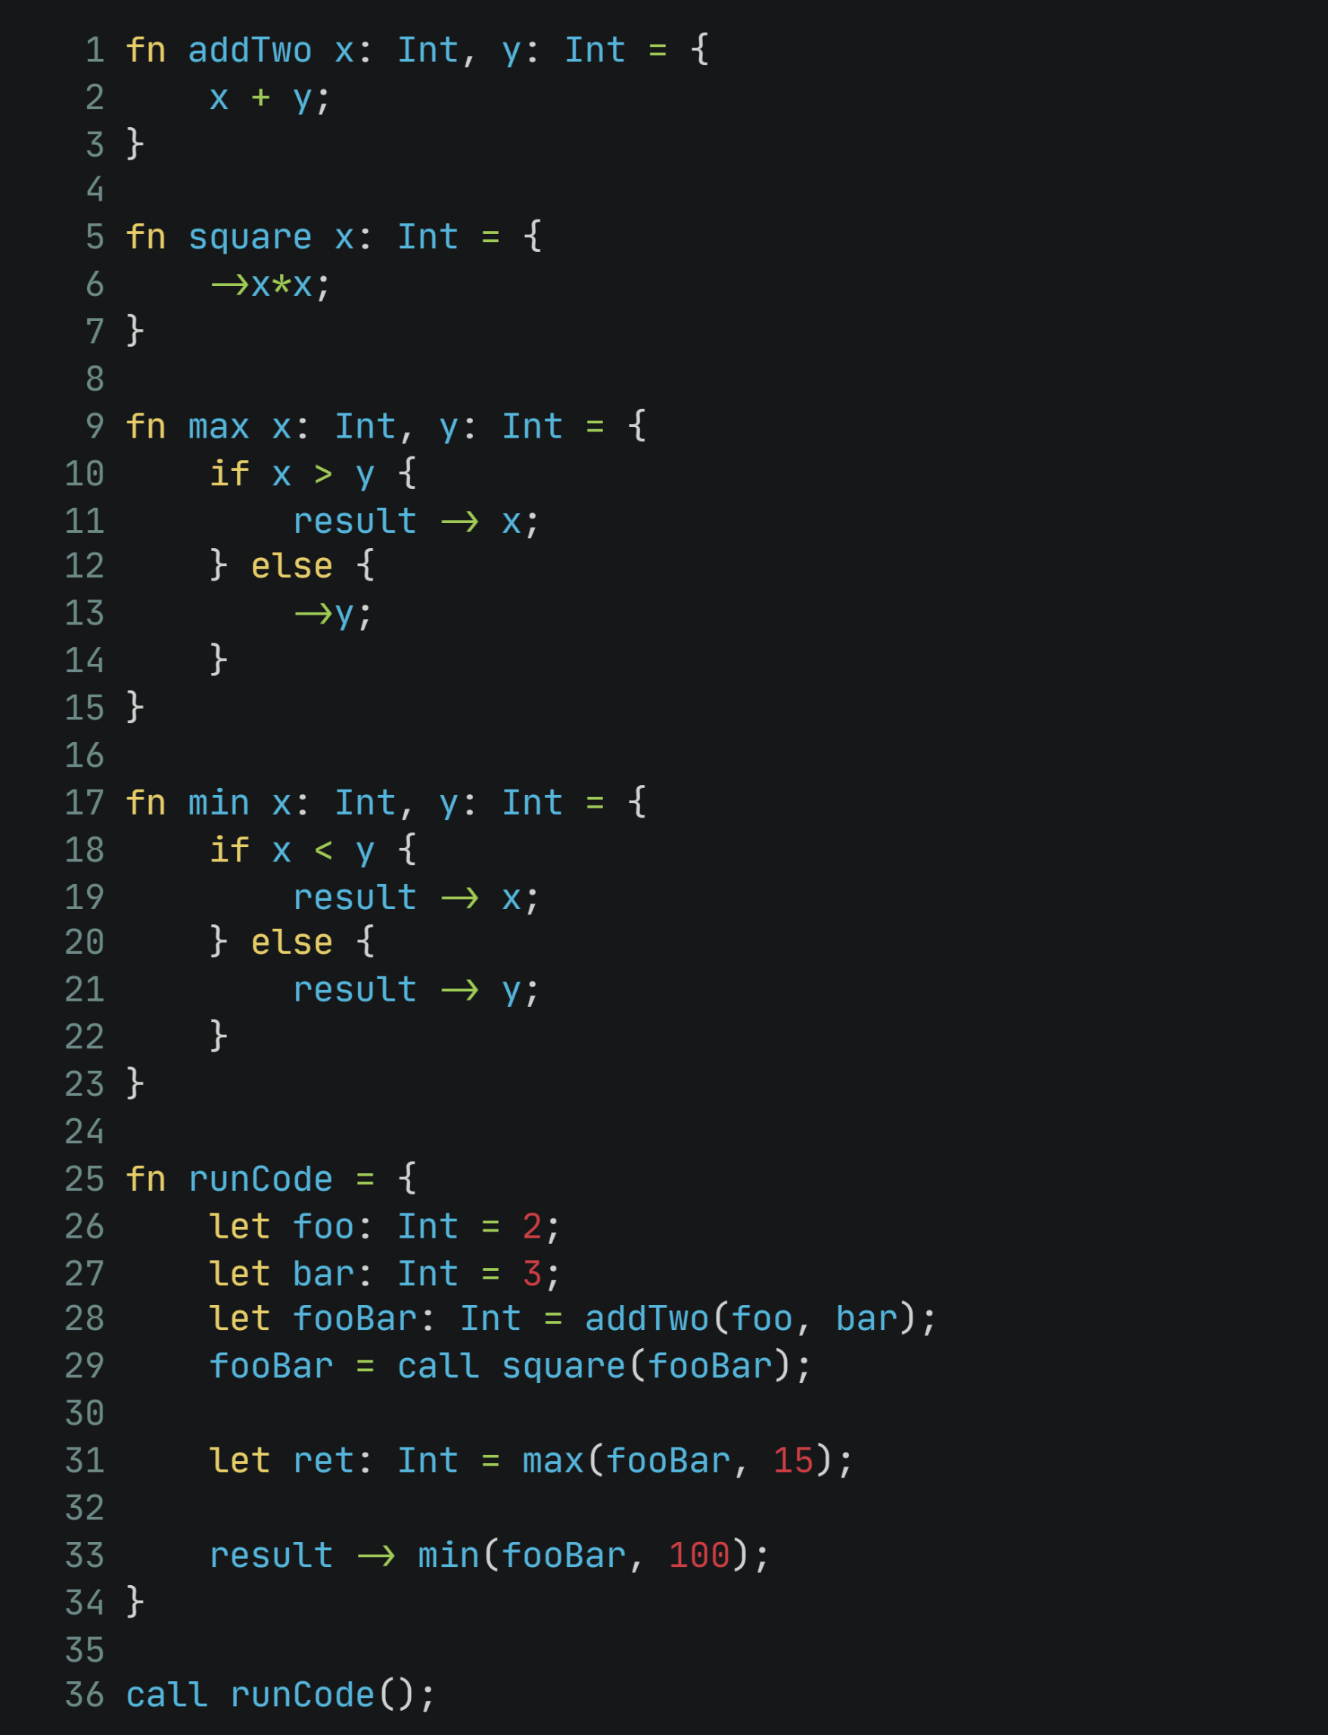
Silhouette-lang Examples
Functions

Slide 10
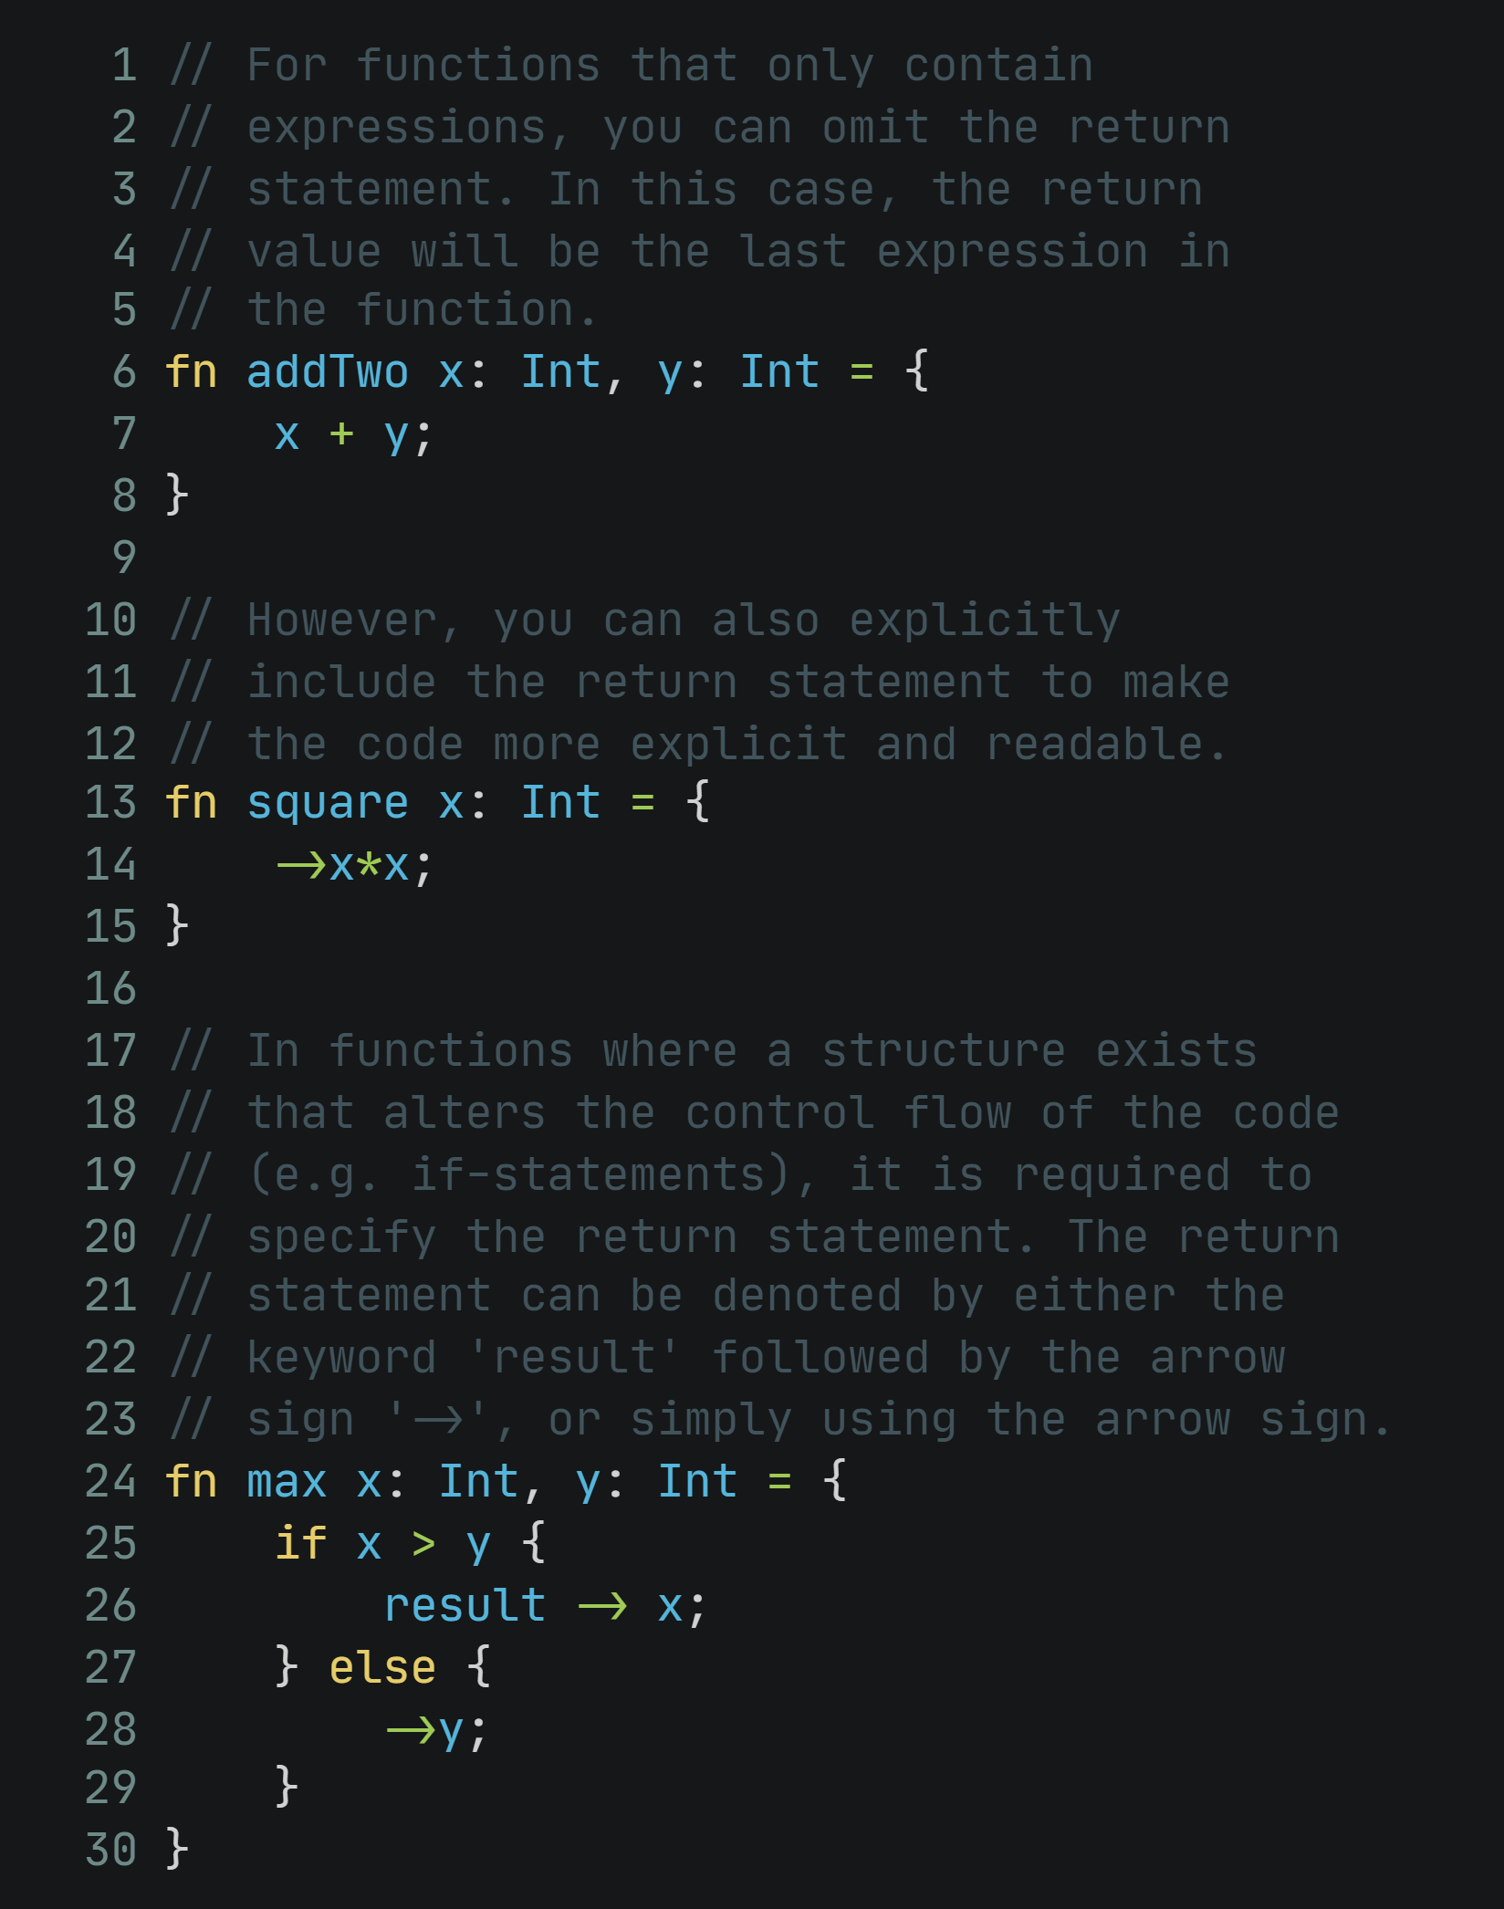
Silhouette-lang Examples
Functions Notes

Slide 11
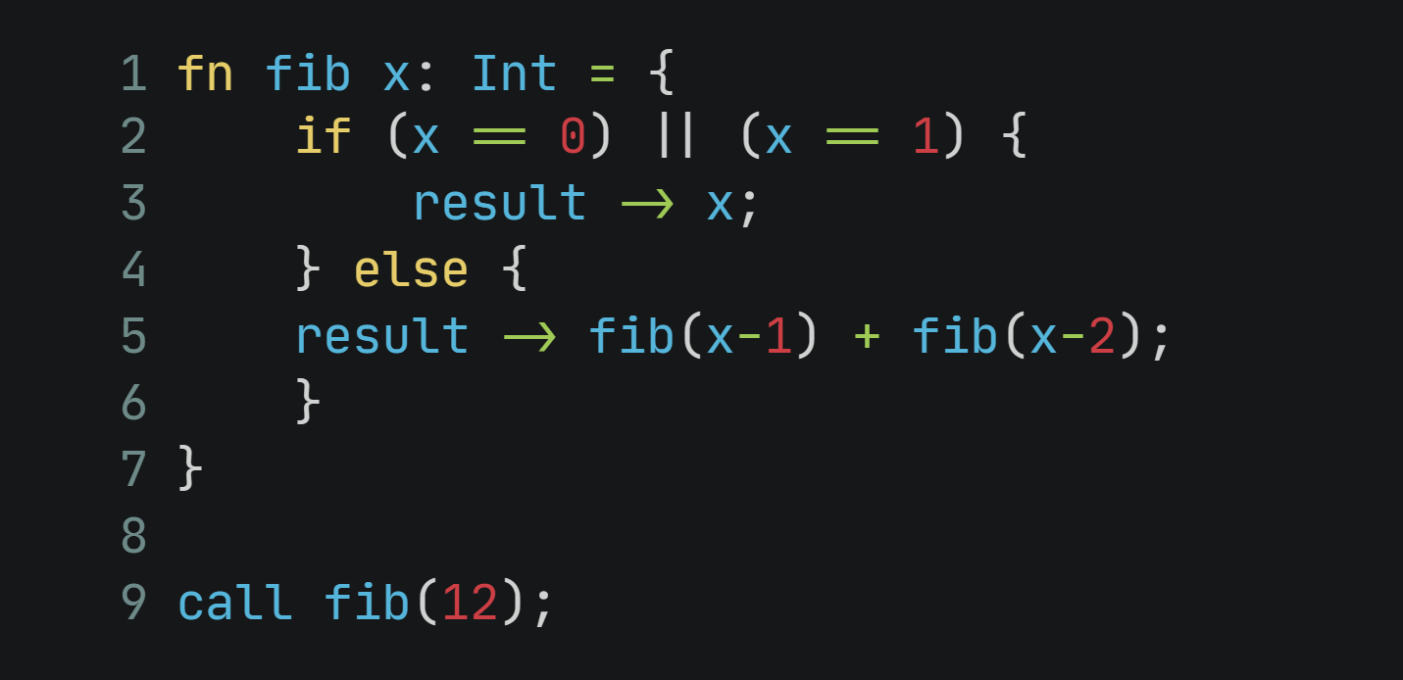
Silhouette-lang Examples
Recursion (Loops)

Slide 12
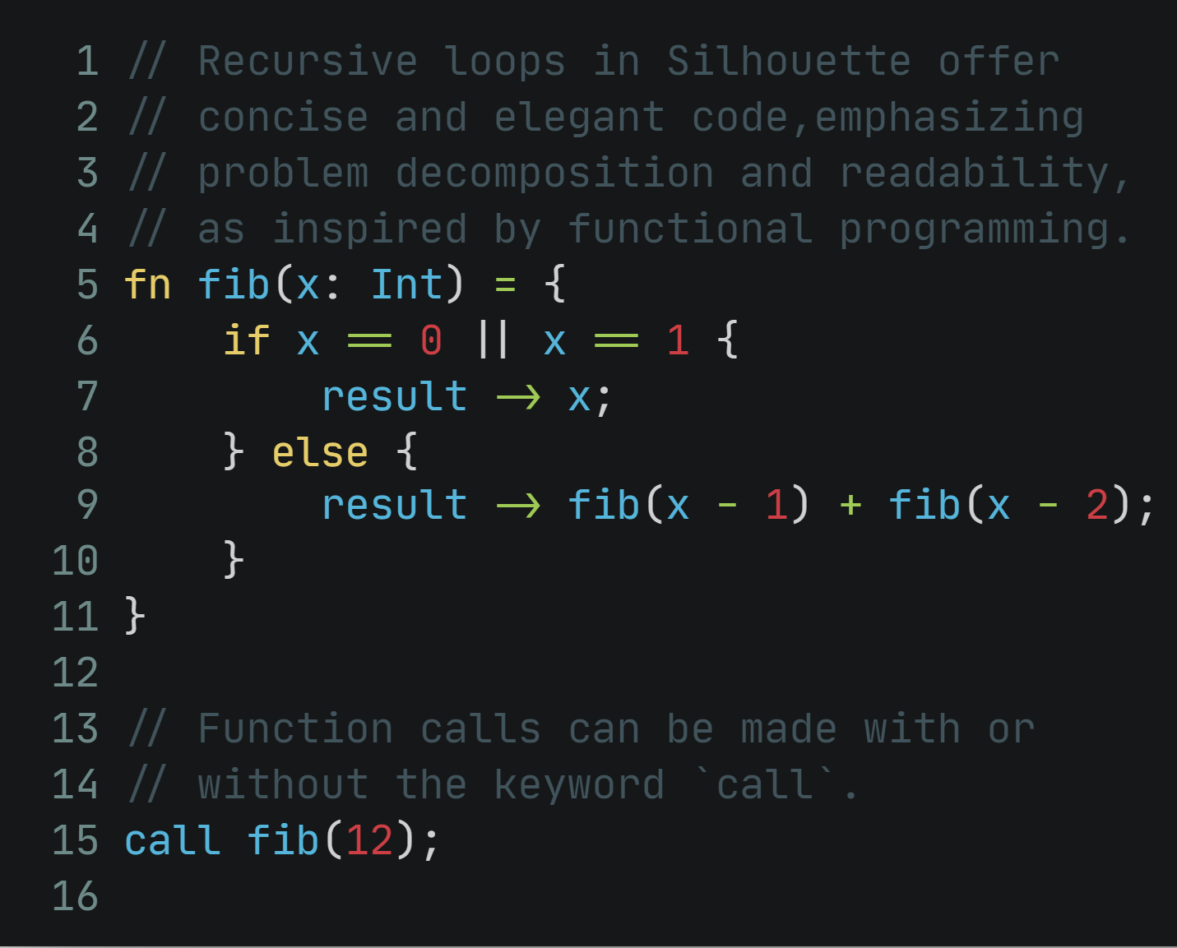
Silhouette-lang Examples
Recursion (Loops) Notes

